Slide 1

Postgres Performance Practices
Squeezing Efficiency From A Database

Slide 2

What Started Me Down This Road
We ran across a SQL statement similar to this:
SELECT * FROM orders WHERE order_id = 123456 ORDER BY order_id LIMIT 1;
order_id is a primary key.
And it ran, like, forever!
I wanted to know why.

Slide 3

Why We Are Here
Balancing database performance can be tricky thing. It helps to understand:
The cost of a query using Explain.
The cost of indexes.
How Postgres executes a query. Hint: the Optimizer.
How to put it all together.
Today, we will look at the explain statement and touch lightly on the cost of indexes.

Slide 4
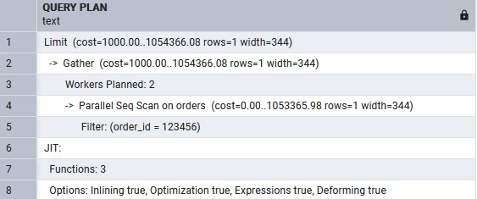
Explaining The Explain: An Explanation
The developer’s rule of thumb with slow-running queries: use the Explain statement to show us how the Postgres Optimizer will process the query.
But what does the an Explain statement tell us?
EXPLAIN SELECT * FROM orders WHERE order_id = 123456 ORDER BY order_id LIMIT 1;
WOAH! What’s all this, then?
Notes:
Run live example.

Slide 5

Explaining The Explain: An Explanation Simplified
TMI!
Let’s start with something simpler, then work our way up.
EXPLAIN SELECT * FROM orders;
Yeah, that’s better!
But what does it mean?
It’s an estimation of work, not an absolute value. And it’s an abstraction of the work performed to execute the query.
This must be distinctly understood, or nothing wonderful can come of the information I'm going to relate.
Notes:
Run live example.

Slide 6



Explaining The Explain: Query Results – Basic Stuff
orders is the relation (table) the query will operate on.
rows is the estimated number of rows the query will operate on.
width is the estimated average width of the rows the query will operate on.

Slide 7

Explaining The Explain: What Are Nodes
Postgres uses nodes to perform actions on relation to return a result. Nodes are functions.
Nodes are stackable:
Parent Node
Child Node 1
Child Node 2
Parallel Child Node n
Work from the bottom up. The output of a, child node is the input to the node above it.
You know it’s a node because nodes have costs: cost=startup..execution

Slide 8
Explaining The Explain: Types of Nodes
Sequential Scan
Default table scan when the optimizer can't find a better option.
No index or the filtering isn't very limiting.
Expensive
Reads every tuple (row) in the relation.
Index Node
Used when the optimizer can use an index.
Index Scan: Uses an index -> seeks the tuples -> then reads the table for data. Relatively expensive.
Index Only Scan: An Index Scan that returns all the requested data from the index, making the table read unnecessary.
Bitmap Index Scan: Builds a bitmap in memory of where the tuples are that satisfy the search criteria.
There are additional Nodes for filtering and joining tables, working in parallel, sorting, and aggregating.

Slide 9

Cost: Startup and Execution
Cost=startup..execution. Two separate values: not a range.
The actual estimated cost = startup cost + execution cost!
The startup cost is how much work Postgres has to do to fetch the first row. It is also called the warm up cost. I have not found a formula for this. Yet!
The execution cost is an estimation of the expected work Postgres must do to run the query. This formula defines the expected upper limit to the cost.
Execution cost = number of blocks in table * page count + number of records in table * cpu tuple cost + number of records in table * cpu operator cost
What does that mean?
Notes:
Run live example.

Slide 10
Execution Cost
Execution cost = number of blocks in table * page count + number of records in table * cpu tuple cost + number of records in table * cpu operator cost
= 949513 * 1 + 20000000 * (0.01 + 0.0025)
= 1,199,513
But that does not equal 1,148,910.73, as reported by the Explain output.

Slide 11

Execution Cost Is An Estimated Upper Limit
The planner has access to more statistics and values that affect this calculations than this formula uses. These statistics affect the planner’s estimations in a more complex manner than that simple formula shows.
The takeaways here are:
We kind of understand what the estimate means: how much work Postgres “thinks” it has to do.
Rely on the Explain output for the estimates.
The estimate is an abstract value reflecting the relative amount of work performed.
The cost can change with every Explain query.

Slide 12
Explaining the Explain: Back To The Complex Query
So, time to look at the more complicated query:
EXPLAIN SELECT * FROM orders WHERE order_id = 123456 ORDER BY order_id LIMIT 1;
Now we can understand all this. We just have to break it down.

Slide 13

Explaining The Explain: What’s This JIT?
“Just-in-Time (JIT) compilation is the process of turning some form of interpreted program evaluation into a native program, and doing so at run time.”
– PostgreSQL 14 documentation, section 32.1
This is extraneous information. It tells us how many functions (nodes) were used (3); that the code from the functions is in-lined, not called; and other parameters, such as Optimization was used.

Slide 14

Explaining The Explain: Working From Bottom To Top
5. Informational: not a node (no cost estimate). Looking for a specific order_id.
4. Node: a Parallel Sequential Scan. No start cost. Final estimated cost = 1,053,365.98.
3. Informational: Postgres plans to use two threads to process the query in parallel.
Note that the cost is less than the cost of an unfiltered scan: 1,148,910.73, but not by much. The filtered scan may be cheaper to run in parallel, but it is filtering, which ups the workload.

Slide 15
Explaining The Explain: Continuing From Bottom To Top
Line 2 shows Postgres using the Gather node to combine the results of the two worker threads.
It estimates that the start up cost to perform the function is 1,000.
The execution cost is approximately the execution cost of the child nodes: 1,054,366.08. ThIs is not cumulative, not in addition to the work of the child nodes.
The total estimated cost for all the work performed is:
Cost = start + execution = 1,000.00 + 1,054,366.08 = 1,055,366.08.

Slide 16
Explaining The Explain: Finishing From Bottom To Top
Line 1 shows the final cost. Postgres uses the Limit node to limit the results returned by the query. It is extraneous here, since the query already is filtered to one row by the WHERE clause, so it does not increase the cost.
If the WHERE clause selected more than one row, this would be different.
The final cost of this query is the same as Line 2:
Cost = start + execution = 1,000.00 + 1,054,366.08 = 1,055,366.08.

Slide 17
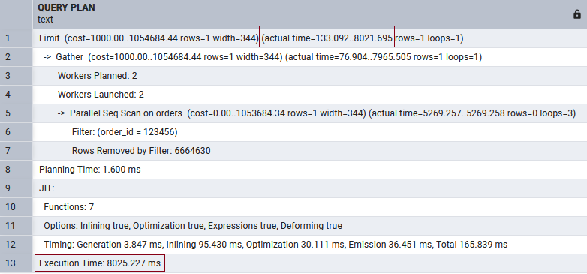
Explain Analyze Runs The Query, Giving More Information
EXPLAIN ANALYZE SELECT * FROM orders WHERE order_id = 123456 ORDER BY order_id LIMIT 1;
Line 1 shows the actual start cost was 133 milliseconds, and the execution time was 8021 ms.
It took over 8 seconds to run this query.
Beware! EXPLAIN ANALYZE executes the query. This isn’t a problem for a read, but it can be for a query that modifies the data.

Slide 18
It’s Still An Expensive Query
The order table is big for the machine this sample is running on, but it’s not huge. Why does a simple query take 8 furshlugginer seconds?!
Why? The table has no indexes. Every operation on the table will require Postgres to scan the entire table or, at least, enough of the table for Postgres to perform the query,
And that can be expensive!
So, the answer is slap an index or two on the table and everything’s cool.
Well, it’s not that simple.

Slide 19
The Cost Of Indexes
Indexes boost performance, but not for free. Indexes take a space in the database.
-- The Order table size without indexes. SELECT pg_size_pretty(pg_total_relation_size('orders')); -- 7420 MB
ALTER TABLE orders ADD PRIMARY KEY (order_id);
-- The Order table size with indexes. SELECT pg_size_pretty(pg_total_relation_size('orders')); -- 7849 MB, an increase of 7849 - 7420 = 429 MB.
Adds 429 MB for an index.

Slide 20
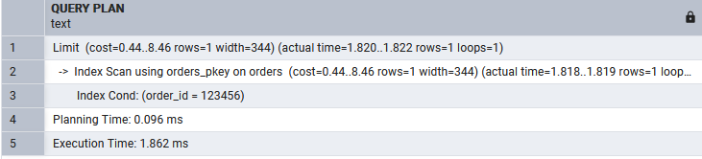
The Benefits Of Indexes
Reads are faster; however, creates, updates, and deletes are slower. Postgres must now update the indexes as well as the table. This isn’t bad for a few, small indexes.
But check this out!
-- Now we have and index! EXPLAIN ANALYZE SELECT * FROM orders WHERE order_id = 123456 ORDER BY order_id LIMIT 1; -- Execution Time: 1.862 ms
So 2 ms with an index vs. 8,000 ms without!

Slide 21

The Next Episodes
Next:
A deeper look at what EXPLAIN ANALYZE tells us about actual costs.
How Postgres executes SQL statements.
Look into the costs and benefits of indexes.
Types of indexes: strengths and weaknesses.
Future:
Indexing text fields.
JSON documents: Postgres’ kludges for working with NoSQL data.

Slide 22

Questions and Comments

